Slide 1
CS3210 Tut 5
MPI & Performance of Heterogeneous CPU
Slides inspired from Sriram
+ extra tidbits

Slide 2
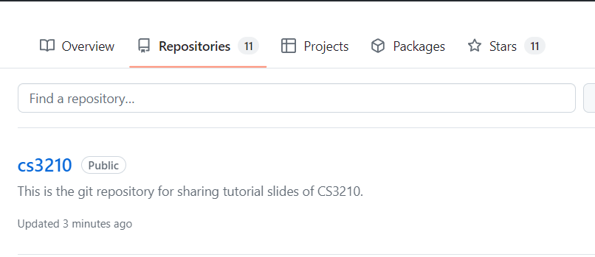
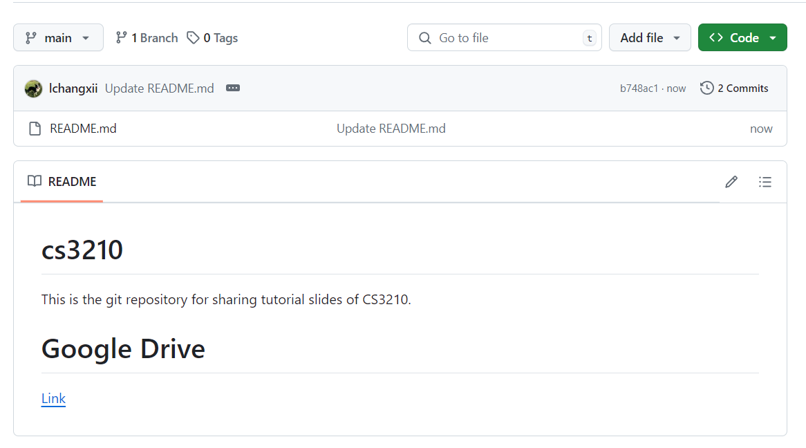
Questions and Slides Sharing
Slides
Github and Google Drive after every session.
https://github.com/lchangxii/cs3210
You can find the Link in the README if preferring Google Drive

Slide 3
Today's topics
MPI communication: in a "logical ring" and avoiding deadlocks
Using these ideas to do pipelined computation
Separate: what happens to performance when we use heterogeneous hardware?

Slide 4
Q1

Slide 5
Logical Ring Communication
int rank, p, size = 8;
int left, right ;
char send_buffer1[8], recv_buffer1[8];
char send_buffer2[8], recv_buffer2[8];
...
MPI_Comm_rank(MPI_COMM_WORLD, &rank)
MPI_Comm_size(MPI_COMM_WORLD, &p)
left = (rank - 1 + p) % p ;
right = (rank + 1) % p ;
...
MPI_Send (send_buffer1, size, MPI_CHAR, left , ...);
MPI_Recv (recv_buffer1, size, MPI_CHAR, right , ...);
MPI_Send (send_buffer2, size, MPI_CHAR, right , ...);
MPI_Recv (recv_buffer2, size, MPI_CHAR, left , ...);
...
(a) How can each process get a unique name?

Slide 6
Logical Ring Communication
int rank, p, size = 8;
int left, right ;
char send_buffer1[8], recv_buffer1[8];
char send_buffer2[8], recv_buffer2[8];
gethostname(send_buffer1, size) //repeat for buffer2
...
MPI_Comm_rank(MPI_COMM_WORLD, &rank)
MPI_Comm_size(MPI_COMM_WORLD, &p)
left = (rank - 1 + p) % p ;
right = (rank + 1) % p ;
...
MPI_Send (send_buffer1, size, MPI_CHAR, left , ...);
MPI_Recv (recv_buffer1, size, MPI_CHAR, right , ...);
MPI_Send (send_buffer2, size, MPI_CHAR, right , ...);
MPI_Recv (recv_buffer2, size, MPI_CHAR, left , ...);
...
If there are two processes on the same node: sprintf(send_buffer1, “rank %d”, …, rank)
How about finishing up the Sends & Recvs?

Slide 7
Logical Ring Communication
int rank, p, size = 8;
int left, right ;
char send_buffer1[8], recv_buffer1[8];
char send_buffer2[8], recv_buffer2[8];
gethostname(send_buffer1, size) //repeat for buffer2
...
MPI_Comm_rank(MPI_COMM_WORLD, &rank)
MPI_Comm_size(MPI_COMM_WORLD, &p)
left = (rank - 1 + p) % p ;
right = (rank + 1) % p ;
...
MPI_Send (send_buffer1, size, MPI_CHAR, left , TAG_LEFT, MPI_COMM_WORLD);
MPI_Recv (recv_buffer1, size, MPI_CHAR, right , TAG_LEFT, MPI_COMM_WORLD, MPI_STATUS_IGNORE);
MPI_Send (send_buffer2, size, MPI_CHAR, right , TAG_RIGHT, MPI_COMM_WORLD);
MPI_Recv (recv_buffer2, size, MPI_CHAR, left , TAG_RIGHT, MPI_COMM_WORLD, MPI_STATUS_IGNORE);
printf(“my name: %s; left: %s; right: %s\ n”, send_buffer1, recv_buffer1 , recv_buffer2); // or cout
Assume TAG_LEFT and TAG_RIGHT tags are assumed distinct values.

Slide 8
Let's try to run it!
vim q1a.c
mpirun -np 4 ./q1a | sort
salloc -n 4 -N 4 mpirun ./q1a | sort

Slide 9
Something like a classic synchronization problem?
MPI_Send left MPI_Recv right MPI_Send right MPI_Recv left

Slide 10
Something like a classic synchronization problem?
MPI_Send left MPI_Recv right MPI_Send right MPI_Recv left
Processes are "chopsticks"
They can only be sending or receiving messages at any point of time but not both
Messages are "philosophers"
Requires a sending end and receiving end to be processed (i.e. 2 chopsticks)

Slide 11
Something like a classic synchronization problem?
This will happen if MPI_Send is not buffered.
If all processes send to left neighbour, messages all have sending ends but do not have receiving ends.
Deadlock!

Slide 12
Deadlock showcase
Using a larger message size (20000 bytes) to ensure MPI_Send is not buffered
vim q1b.c
salloc -n 4 -N 1 mpirun ./q1b

Slide 13
How do we fix this?
MPI_Send ( send_buffer1, size, MPI_CHAR, left , ...);
MPI_Recv ( recv_buffer1, size, MPI_CHAR, right , ...);
MPI_Send ( send_buffer2, size, MPI_CHAR, right , ...);
MPI_Recv ( recv_buffer2, size, MPI_CHAR, left , ...);

Slide 14
How do we fix this? Even-odd solution
if (rank % 2 == 0) {
// send before recv
MPI_Send ( send_buffer1, size, MPI_CHAR, left , ...);
MPI_Recv ( recv_buffer1, size, MPI_CHAR, right , ...);
MPI_Send ( send_buffer2, size, MPI_CHAR, right , ...);
MPI_Recv ( recv_buffer2, size, MPI_CHAR, left , ...);
} else {
// recv before send
MPI_Recv ( recv_buffer1, size, MPI_CHAR, right , ...);
MPI_Send ( send_buffer1, size, MPI_CHAR, left , ...);
MPI_Recv ( recv_buffer2, size, MPI_CHAR, left , ...);
MPI_Send ( send_buffer2, size, MPI_CHAR, right , ...);
}

Slide 15
How do we fix this? Right-handed philosopher
if (rank < size - 1) { // All except the last rank sends normally
MPI_Send ( send_buffer1, size, MPI_CHAR, left , ...);
MPI_Recv ( recv_buffer1, size, MPI_CHAR, right , ...);
MPI_Send ( send_buffer2, size, MPI_CHAR, right , ...);
MPI_Recv ( recv_buffer2, size, MPI_CHAR, left , ...);
} else { // This is executed only by the last rank
MPI_Recv ( recv_buffer1, size, MPI_CHAR, right , ...);
MPI_Send ( send_buffer1, size, MPI_CHAR, left , ...);
MPI_Recv ( recv_buffer2, size, MPI_CHAR, left , ...);
MPI_Send ( send_buffer2, size, MPI_CHAR, right , ...);
}

Slide 16
Which solution is faster?
vim q1c_rh.c
time salloc -n 4 -N 1 mpirun ./q1c_rh
time salloc -n 4 -N 1 mpirun ./q1c

Slide 17
Which solution is likely to be faster?
Even-odd
Can complete in 4 “rounds” of communication
Even send, odd receive → Even receive, odd send (left) → repeat these steps for the right-wise send
Right-handed
Everyone except one rank sends to the right but is blocked
Last rank receives and unblocks second-last rank to receive
Repeat.. takes far more steps

Slide 18
Logical Ring Communication
int rank, p, size = 8;
int left, right ;
char send_buffer1[8], recv_buffer1[8];
char send_buffer2[8], recv_buffer2[8];
gethostname(send_buffer1, size) //repeat for buffer2
...
MPI_Comm_rank(MPI_COMM_WORLD, &rank)
MPI_Comm_size(MPI_COMM_WORLD, &p)
left = (rank - 1 + p) % p ;
right = (rank + 1) % p ;
...
MPI_Send (send_buffer1, size, MPI_CHAR, left , ...);
MPI_Recv (recv_buffer1, size, MPI_CHAR, right , ...);
MPI_Send (send_buffer2, size, MPI_CHAR, right , ...);
MPI_Recv (recv_buffer2, size, MPI_CHAR, left , ...);
printf(“my name: %s; left: %s; right: %s\ n”, send_buffer1, recv_buffer1 , recv_buffer2); // or cout
What if we use ISend and IRecv? How do we write it?

Slide 19
Logical Ring Communication
int rank, p, size = 8;
int left, right ;
char send_buffer1[8], recv_buffer1[8];
char send_buffer2[8], recv_buffer2[8];
gethostname(send_buffer1, size) //repeat for buffer2
...
MPI_Comm_rank(MPI_COMM_WORLD, &rank)
MPI_Comm_size(MPI_COMM_WORLD, &p)
left = (rank - 1 + p) % p ;
right = (rank + 1) % p ;
MPI_Request reqs[4]; MPI_Status stats[4];
MPI_ISend (send_buffer1, size, MPI_CHAR, left , TAG_LEFT, MPI_COMM_WORLD, &reqs[0]);
MPI_IRecv (recv_buffer1, size, MPI_CHAR, right , TAG_LEFT, MPI_COMM_WORLD, MPI_STATUS_IGNORE, &reqs[1]);
MPI_ISend (send_buffer2, size, MPI_CHAR, right , TAG_RIGHT, MPI_COMM_WORLD, &reqs[2]);
MPI_IRecv (recv_buffer2, size, MPI_CHAR, left , TAG_RIGHT, MPI_COMM_WORLD, &reqs[3]);
MPI_Waitall(4, reqs, stats);
printf(“my name: %s; left: %s; right: %s\ n”, send_buffer1, recv_buffer1 , recv_buffer2); // or cout
What if we use ISend and IRecv? How do we write it?

Slide 20
Let's try it!
vim q1d.c
time salloc -n 4 -N 1 mpirun ./q1d
time salloc -n 4 -N 1 mpirun ./q1c

Slide 21
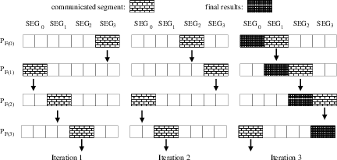
Why does this question matter?
Logical ring (or generalized more to Cartesian grid) layouts are useful for many problems (simulations, array ops, etc)
Looks like a pipeline: but also comes with synchro issues since it’s not just unidirectional

Slide 22
Q2

Slide 23
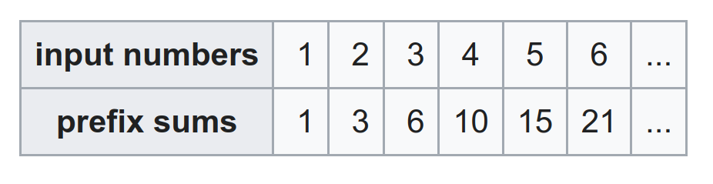
Q2: Prefix Sums
Each element in the prefix sum output is the running total of all input numbers up to that index.
E.g. 6 = 1 + 2 + 3
How can we design a pipelined MPI program to do this?

Slide 24
Q2: Prefix Sums
How can we design a pipelined MPI program to do this?
Rank 1
Rank 2
Rank N
…
1
2
N

Slide 25
Q2: Prefix Sums
How can we design a pipelined MPI program to do this?
Each rank gets the prefix sums so far from prev rank and adds its own number to produce the next sum (recv → add → send)
Rank 1
Rank 2
Rank N
…
1
2
N

Slide 26
Let's try it!
vim q2.c
salloc -n 4 -N 1 mpirun ./q2_4
salloc -n 200 -N 1 --overcommit mpirun ./q2

Slide 27
Q2: Prefix Sums
What is the maximum theoretical speedup if we have to process an infinite number of size N arrays?
* ∞
Rank 1
Rank 2
Rank N
…
1
2
N

Slide 28
Q2: Prefix Sums
What is the maximum theoretical speedup if we have to process an infinite number of size N arrays?
In a magical world: theoretical pipeline speedup limit is N
Not remotely possible with communication delays >> computation like this!
Rank 1
Rank 2
Rank N
…
1
2
N

Slide 29
Q2: Prefix Sums
What if we can use MPI_Scan?
Rank 1
Rank 2
Rank N
…
1
2
N

Slide 30
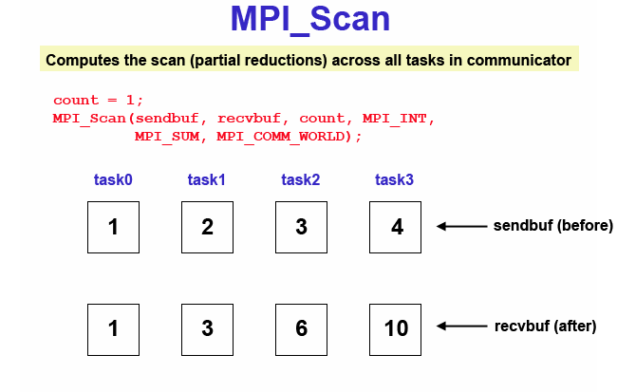
Q2: Prefix Sums
What if we can use MPI_Scan?
Same, must scatter first, then…
Call MPI_Scan with input and output arrays. Any limitations?
Rank 1
Rank 2
Rank N
…
1
2
N
1
3
…

Slide 31
Q2: Prefix Sums
Any limitations?
MPI_Scan results are left in the indiv ranks, need to MPI_Gather the results for printing!
MPI_Scan is not pipelineable! It must complete the computation of an entire prefix sum first.
Rank 1
Rank 2
Rank N
…
1
2
N
1
3
…

Slide 32
Let's try it!
salloc -n 200 -N 1 --overcommit /usr/bin/time -vvv mpirun ./q2_noprint
How long will the MPI_Scan version take?
salloc -n 200 -N 1 --overcommit /usr/bin/time -vvv mpirun ./q2_scan
How long do you think the serial version will take?
time ./q2_serial

Slide 33
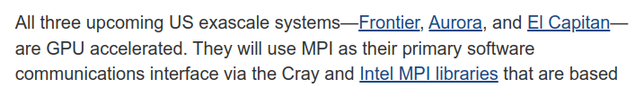
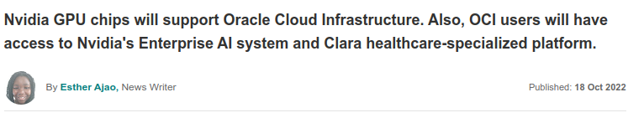
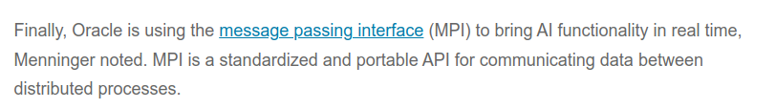
Why does this question matter?
These “toy” examples are clearly not faster than just running things on a single node (with threads at best)
However, most significant high-performance computing uses MPI to solve such problems → scale makes this much better!

Slide 34
Q3

Slide 35
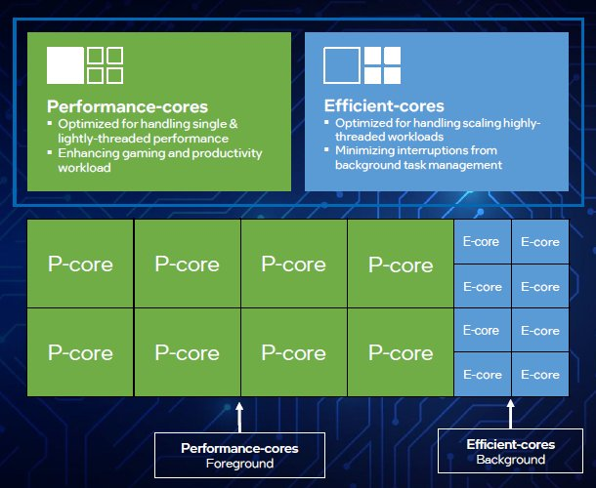
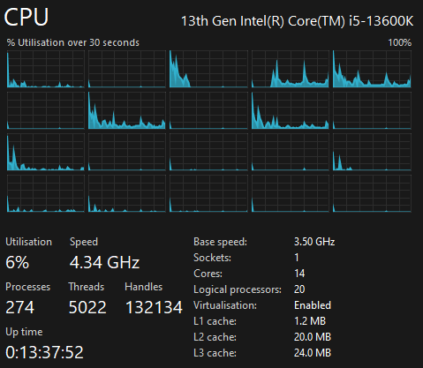
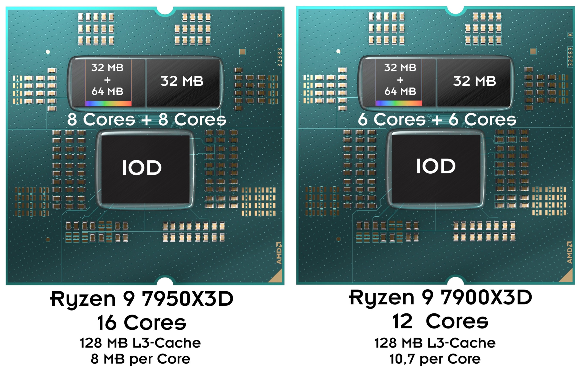
“Wimpy” and “Brawny”: A Research Success!
Back then: ARM big.LITTLE (mostly used in phones)
Now
Intel Alder Lake/Raptor Lake/Arrow Lake (2 types of processing cores w/ differing instruction sets, clock speeds, L1+L2 cache & Hyperthreading)
AMD Ryzen 7900X3D, 7950X3D (2 types of chiplets, comprising of processing cores that differ in L3 cache size and clock speed)

Slide 36
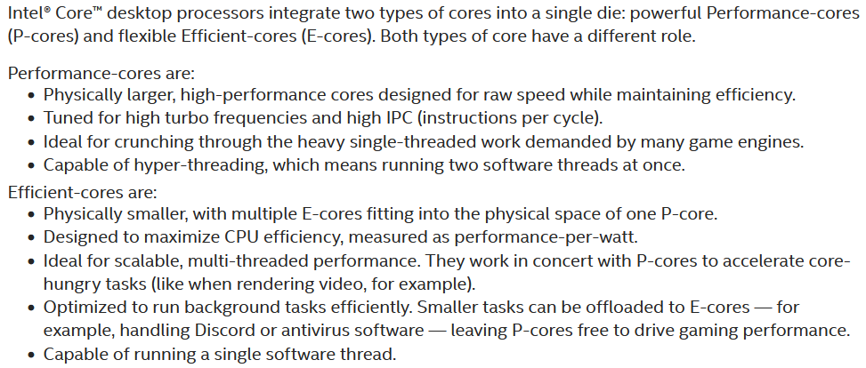
“Wimpy” and “Brawny”: A Research Success!
https://www.intel.com/content/www/us/en/gaming/resources/how-hybrid-design-works.html

Slide 37
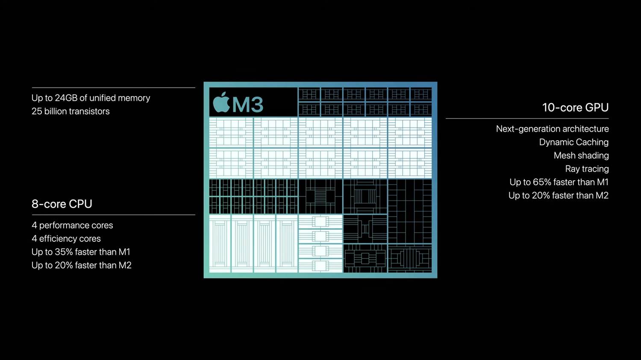
“Wimpy” and “Brawny”: A Research Success!
Notes:
don't mind me, i love following hardware trends

Slide 38
The Setup
You have to decide between 3 designs for a processor
Brawny cores are 2x as fast and use 4x more power than Wimpy ones
You only care about a benchmark with parallelizable fraction f, serial cannot overlap with parallel, parallel portion can get linear speedup
Design 1
Design 2
Design 3
Benchmark
Serial
(1 - f)
Parallelizable
f
Wimpy
Wimpy
Wimpy
Brawny
Brawny
Wimpy
Wimpy
Wimpy
Wimpy
Wimpy
Wimpy
Wimpy
Wimpy
Wimpy
Single wimpy: Benchmark takes 200s
Wimpy
Wimpy
Wimpy
Brawny
Brawny
Brawny
Brawny
Wimpy
Wimpy
Wimpy
Single brawny:
Benchmark takes 100s

Slide 39
Q3a
What is the time taken for a system w/ N_{wimpy} cores & parallelizable fraction f?
Design 1
Benchmark
Serial
(1 - f)
Parallelizable
f
Wimpy
Wimpy
Wimpy
Wimpy
Wimpy
Wimpy
Single wimpy: Benchmark takes 200s
Wimpy
Wimpy
Wimpy
Wimpy
Wimpy
Wimpy
Single brawny:
Benchmark takes 100s

Slide 40
Q3a
What is the time taken for a system w/ N_{wimpy} cores & parallelizable fraction f?
Serial Part: 200(1-f) Parallel part: 200f/N_{wimpy} Total = 200(1-f) + 200f / N_{wimpy} = 200((1-f) + (f/N_{wimpy}))
Design 1
Benchmark
Serial
(1 - f)
Parallelizable
f
Wimpy
Wimpy
Wimpy
Wimpy
Wimpy
Wimpy
Single wimpy: Benchmark takes 200s
Wimpy
Wimpy
Wimpy
Wimpy
Wimpy
Wimpy
Single brawny:
Benchmark takes 100s

Slide 41
Q3b
What is the time taken for a system w/ N_{wimpy} cores, N_{brawny} cores and parallelizable fraction f?
Benchmark
Serial
(1 - f)
Parallelizable
f
Wimpy
Wimpy
Wimpy
Wimpy
Wimpy
Wimpy
Single wimpy: Benchmark takes 200s
Brawny
Brawny
Single brawny:
Benchmark takes 100s

Slide 42
Q3b
What is the time taken for a system w/ N_{wimpy} cores, N_{brawny} cores and parallelizable fraction f?
Serial part: 100(1-f) → We use brawny core for this!
For parallel: We want to use brawny and wimpy cores to finish at the same time, so allocate each brawny 2x the work of a wimpy
Parallel is: 200f / (2N_{brawny}+N_{wimpy})
Sum serial + parallel to get total time
Serial
(1 - f)
Parallelizable
f
Wimpy
Wimpy
Wimpy
Wimpy
Wimpy
Wimpy
Single wimpy: Benchmark takes 200s
Brawny
Brawny
Single brawny:
Benchmark takes 100s

Slide 43
Q3c: Energy - Speed Tradeoff
Skipping towards the final results; calculations should be trivial.
20 wimpy: 200J of energy and runs in 29 seconds
5 brawny: 400J of energy and runs in 28 seconds
4 wimpy + 4 brawny: 340J of energy and runs in 25 seconds

Slide 44
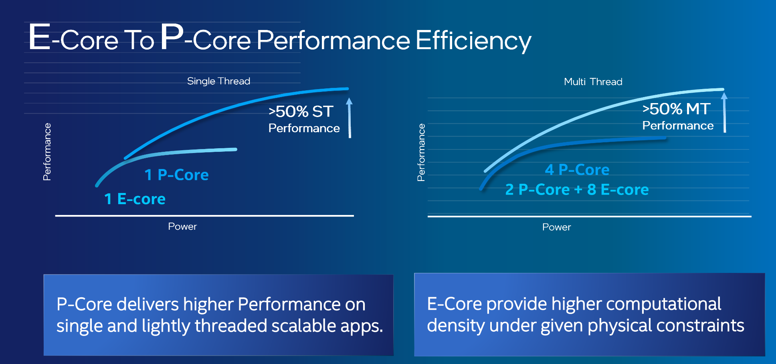
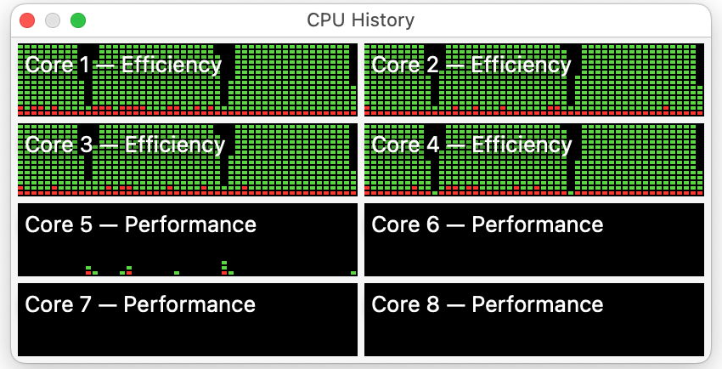
Why does this question matter?
Looks like a new golden era of heterogenous cores!
Single-threaded performance: “Brawny” / “P-Cores”
Multi-threaded performance per watt: “Wimpy” / “E-Cores”
Wimpy cores use less power per unit performance

Slide 45
Assignment 3

Slide 46
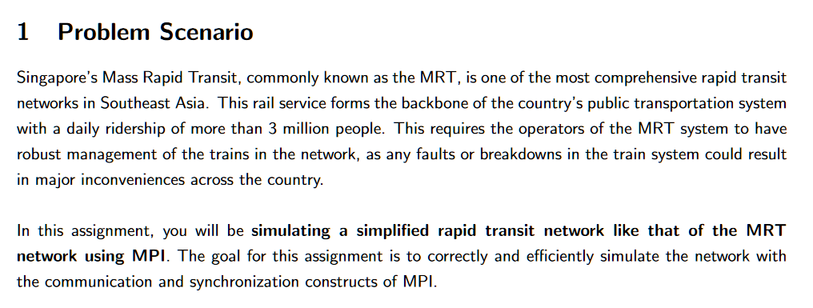
Assignment 3
Notes:
./generate_test_output.sh 1 1 1 1 tests/dipsy.in
rm logs/*.slurmlog;sbatch config1.sh 1 1 1 1 tests/dipsy.in

Slide 47
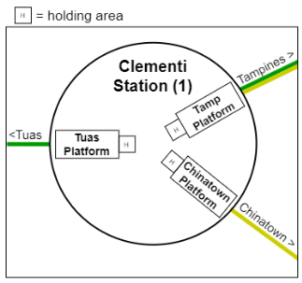
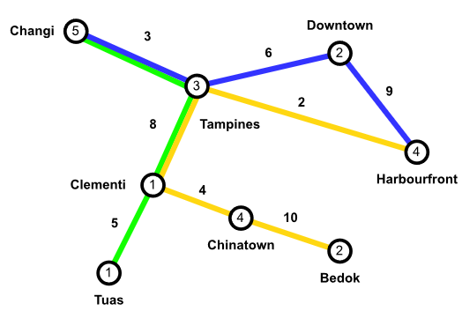
Quick overview of the example

Slide 48
General MPI tips from me
Correct:
Starting on a naïve sequential solution first may not be the ideal strategy this time, it's not trivial to convert a sequential program to an MPI program.
Think about what kind of work you want to distribute among all the processes to process, and then think about the data you need each process to pass from one to another.
Performance
Master the use of MPI collective communication functions. That includes Gather, Gatherv, Scatter, Scatterv, Alltoall, Alltoallv.
minimize the size of data being sent among the processes.
(another small hint: size_t is 8 bytes on a x86_64 architecture, while int is only 4 bytes).

Slide 49
Next week
Next week is Tut 6 + Lab 6
Topic: Interconnects + Performance Measurement
Lab 6 is an optional submission.

Slide 50

End of Tut 5
link
Attendance

